Slide 1
Department of Lay Ministries CME Church Local Lay Leaders Training & Conversation Saturday March 1, 2025
STUDYING
SEEKING
SHARING
SERVING
Presented by: Shannon Faulk - General Secretary of Lay Ministries'
Bishop Marvin Frank Thomas, Chair

Slide 2
AGENDA
Call to order
Prayer
Greetings & Introductions
Purpose & OBJECTIVE OF THE CALL
Department of Lay Ministries Leadership
Priorities and directions
MOVING forward
Open discussion recommendations and suggestions
adjournment
W

Slide 3
Shannon Faulk General Secretary of Lay Ministries
Mailing Address:
400 Corporate Pointe, Ste. 300 Culver City, CA 90230 Phone: 310-902-6836/cell, 855*845-2900/office Email: slfaulk3@aol.com
Administrative Assistant: Ms. Donna Johnson Email: bblzed@comcast.net

Slide 4
Quadrennial theme and mission
LAY THEME:
Bold Faith, Christian Lay, Moving Forward Together!
Acts 4:13-21
MISSION:
Reaching, Teaching, and Ministering to All Generations, Equipping Them for Greater Works and Service For Him.”

Slide 5
The Lay Ministry Beliefs
GUIDING PRINCIPLES
Studying with Purpose & Determination
Seeking and being Sensitive to those who do Not know Christ.
Sharing, with a Sense of Thankfulness.
Serving, with a Glad Heart!

Slide 6
PURPOSE & OBJECTIVES OF THE CALL
Alignment of the Department of Lay Ministries Goals & Priorities
Understanding Leadership Role
Improving lines of communication
Training & Support
Impact at the Local Church
Hearing from you

Slide 7
Progressive Objectives:
Improve Communication
Raise the Profile of the Department of Lay Ministries
Training & Development
Youth, Young Adult and Family Focused
Men Emphasis
Support of the Local Church
Steward, Stewardess, Trustee and Usher Ministries
Community Outreach and Partnerships

Slide 8
DEPARTMENT OF LAY MINISTRIES LEADERSHIP STRUCTURE
The Legislative Branch is represented by the General Conference delegates.
The General Secretary of Lay Ministries…….Department Chair (Bishop Marvin Thomas)
The Connectional Lay Council President
The Connectional Lay Ministry Presidents;

Slide 9
Department of Lay Connectional Officers
Connectional Lay President: Dr. Barbara Campbell
Connectional Steward President: Mr. Freddie McKnight
Connectional Stewardess President: Mrs. Jolinda Dugger
Connectional Trustee President: Atty. Barbara Bouknight
Connectional Usher President: Ms. Dorruth Boyd

Slide 10
DEPARTMENT OF LAY MINISTRIES LEADERSHIP STRUCTURE CONTINUED
Episcopal VP’s
Regional Lay Leaders
District Lay Leaders
Local Lay Leader

Slide 11
LINES OF COMMUNICATION AND INFORMATION PROCEDURE FROM THE LOCAL CHURCH ASCENDING
Lay Member
Local Lay Leader
District Lay Leader
Region Lay Leader
Episcopal
Vice President
CONNECTIONAL PRESIDENTS
GENERAL SECRETARY OF LAY MINISTRIES
REVERSE:
LINES OF COMMUNICATION AND INFORMATION PROCESS FROM THE GENERAL SECRETARY DOWN

Slide 12
Courage is the most important of all the virtues, because without courage you can’t practice any other virtue consistently. –
Maya Angelou

Slide 13
I am a member of the lay department
Now what?

Slide 14
Who are the Laity of the CME Church
Men
Women
Young Adults
Youth
Children
Non-Clergy
Board of Christian Education members
Choir Members
Methodist Men’s Ministry
Missionaries
Recording Stewards
Stewards
Stewardess
Seniors
Treasures
Trustees
Ushers

Slide 15
Paragraph: 1160: The General Department of Lay Ministry
1. There shall be in the Christian Methodist Episcopal Church an organization known as the General Department of Lay Ministry.
2. The Executive Officer shall be a General Secretary elected according to the provision set forth by the General Conference.
3. (a through J) List the objectives of the Department

Slide 16
The Department of Lay Connectional Ministries
Per the Book the book of Discipline , Chapter 52, Paragraph 1160
The Connectional Ministries:
The Stewardess
The Stewards
The Ushers
The Trustees

Slide 17
The Lay Ministry Council
The Local Lay Ministry Council is responsible for the program of lay ministry in the local church.
In the CME Church, actions should be carried out as outlined by the Department of Lay Ministry and the CME Book of Discipline.
All efforts should be in keeping with the spirit of the Lay Ministry Beliefs, the Lay Ministry Mission, and the Lay Ministry Objectives.

Slide 18
LEADERSHIP FOR MOVING THE CHURCH FORWARD:
Phil. 3: 12-14
1. Paul believed in moving the church forward
2. We can rely on out past laurels or repretation.
3. Moving forward is the only way to avoid decline or failure.

Slide 19
Strategies For Effective Local Lay Ministries
Developing Prayer Warriors.
To encourage church members to be involved in their local communities.
Help create a church environment where people want to come back.
Impactful children's & youth ministries.
Effective use of technology.
Get involved in mission trips where members can share the gospel.
Strive for excellence
Understand that everyone has a gift/talent.

Slide 20
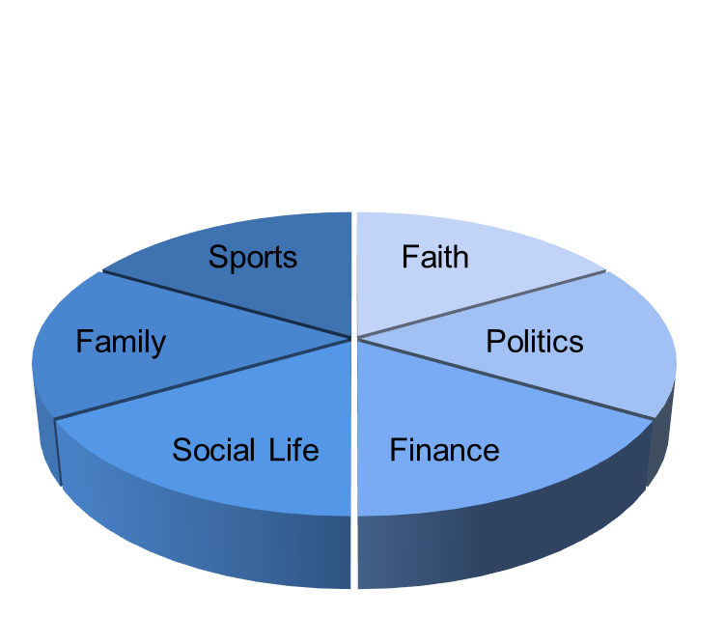
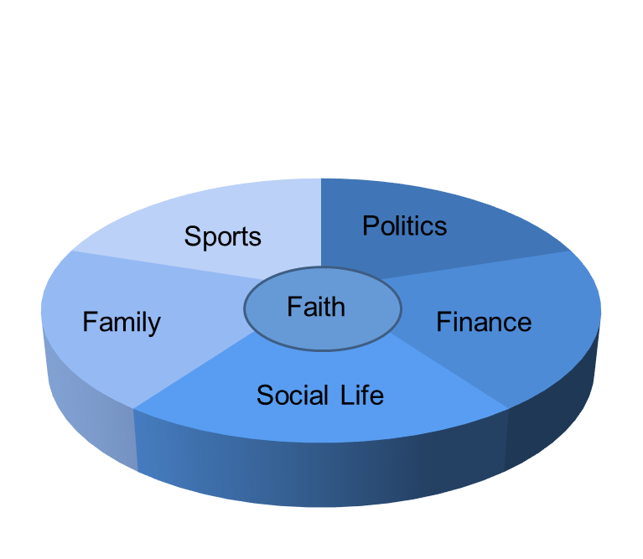
LAY MEMBERS AND INTEGRATED FAITH
SEGMENTED FAITH VS. INTEGRATED FAITH

Slide 21
Where does Ministry Happen?
It happens in our daily activity
It happens through new initiatives
It happens through groups and institutions
It happens through the church…through you and through me

Slide 22
Department of Lay Ministries Priorities & Direction

Slide 23
2025 DEPARTMENT OF LAY MINISTRIES PLANS & OBJECTIVES
1st Quarter;
Trustee Training
Local Lay Leader, Connectional Forum
2nd Quarter:
Stewards Training
Stewardess Training
Local Lay Council Community Service & Outreach Project
Usher Training
3rd Quarter
Finalize Department of Lay Ministries Manuals
Preparing for the Connectional Lay Institute, 2025
4th Quarter:
General Conference Training & Focus

Slide 24
2025 LOCAL LAY LEADER PLAN OF ACTION NEW/INACTIVE LAY COUNCILS
Set a date within the next 60 days to meet with church members to discuss the purpose of the Department of Lay Ministries. Clarify the Why!
Get buy-in from the Pastor, Officers, and key members.
Develop a simple 1-page overview of the Department of Lay Ministries: What is the purpose? How will the Department of Lay Ministries help members of the congregation with their spiritual journey
Build Support through a church-wide community service project/event (during the month of May), such as shoes for the homeless or reading to children.
Encourage your leaders to “shoulder tap” folks they know in the church and personally invite them to join them for their community group.
Build the proper environment at the local church level, find potential leaders (of different ages) to take on a leadership role.
Look at having an organized Lay Council within 90 days after your first meeting.

Slide 26
LET’S TALK
Open Discussion
Recommendations
Suggestions

